Slide 1
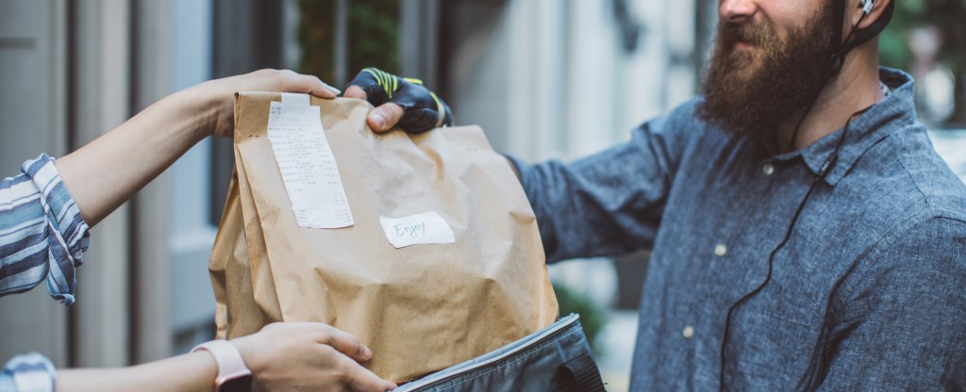
Food Delivery Application (Requirements)
Presented by Yusufjon Akhmedov

Slide 2
Agenda
Introducing yourself
Main goal
Steps needed
Every steps detailed

Slide 3

Introduction
I am Yusufjon Akhmedov (Yusuf) first-year second semester computer engineering student. I have relevant experience in web programming, (Python, PHP, Javascript) I am excited to find about requirement engineering stuff.

Slide 4
MAIN GOAL
Defining
Documenting
Maintaining requirements of Food Delivery Application

Slide 5

REQUIREMENT STEPS
Gathering
Analyzing
Specification
Validation
Management

Slide 6
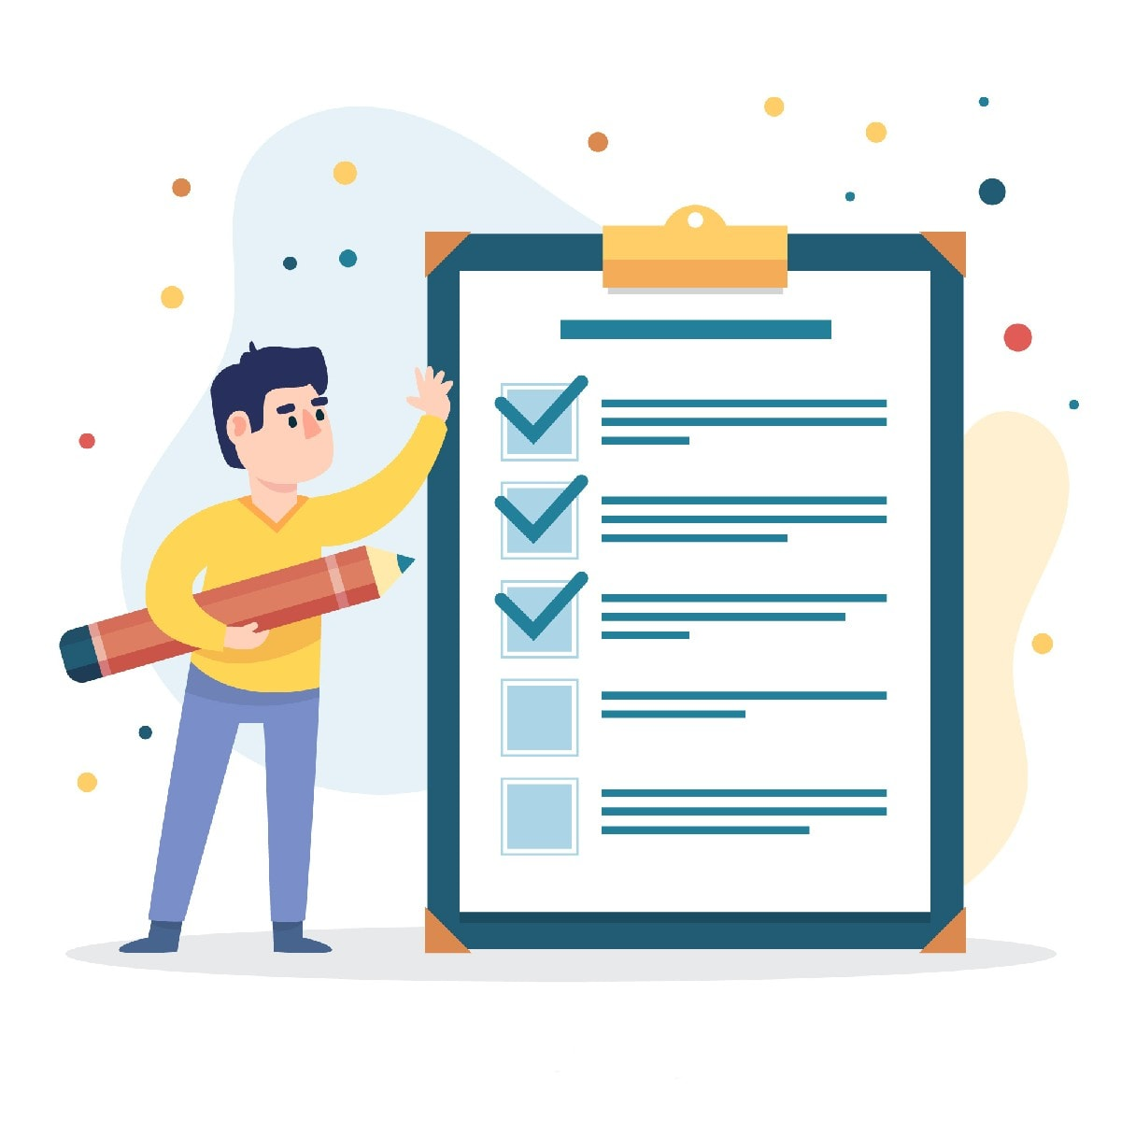
REQUIREMENT GATHERING
Stakeholders: public, restaurants and deliverers
Surveys & Questionnaires
potential large number of users
online messengers, leaflets
Use Cases & Scenarios
Many examples and best practices

Slide 7
REQUIREMENT ANALYSIS
Functional | Non-functional
Register or login with Google or Telegram account | at least 100,000 concurrent users without performance issues
Roles: client ordering, restaurant accepting orders and provide to deliverer carrying the order from A to B. | Response time is up to 2 seconds
One order can include two,more items. | Order confirmation is in 5 minutes
Statuses of order presents the real process of food delivery: pending,payment, cooking, onway, done, cancelled | horizontal scaling using cloud services (AWS, Azure, GCP)
Ranking system for restaurants and EDT (Estimated Delivery Time) based on distance and traffic (Kakao Map) integration | Should support muliple langues, Korean, Uzbek, English, Russian
Inconsistencies
order cancelation, payment issues
Ambiguities
wrong EDT or doubling total price
Feasibilities
free delivery or discounts

Slide 8
SPECIFICATIONS
Software Requirement Specification (SRS)
SRS Document Standart: IEEE 830-1998
Constraints:
Budget: $2,500
Deadline: Final product through 20.05.2025
Technical limitations: FastAPI for backend, MongoDB data storage, Microsoft Azure to deploy, Kafka for notifications, Kakao Map (routing, EDT), Stripe, Kakao Pay for paying

Slide 9
Requirement VALIDATION
Meetup with restaurant owners: 25.03.2025
Reviews from users: YouTube, Instagram
Checking testability: Meeting with developers

Slide 10

Requirement Management
Potential changes
Tool for requirement management
Client wants to add mobile application for tracking orders: +5,000$, +1month, approved
Telegram bot to order foods: +200$, +1week, approved
Monthly reports on graphical charts for each restaurant
RestAPI with clear documentation for POS systems, +250$, approved

Slide 11


Q & A
Relevant questions or offers

